Slide 1
Lecture #3
By: Aqib Rehman

Slide 2
outline
Intro to Forms
Create React App
Single Page Apps
Nesting Components
Props
Outputting Lists
Stateless Components

Slide 3
Intro to Forms

Slide 4
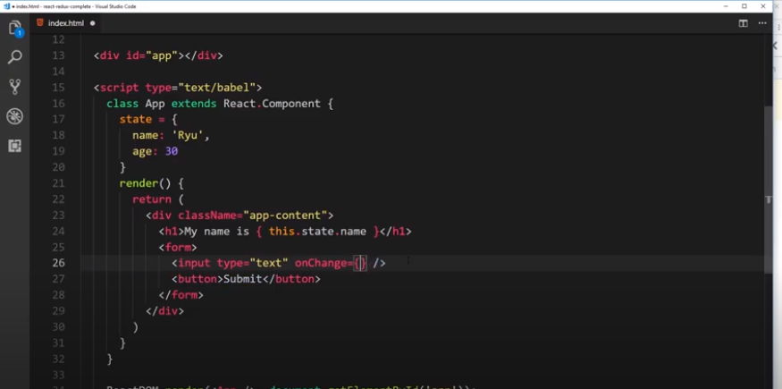

Slide 5
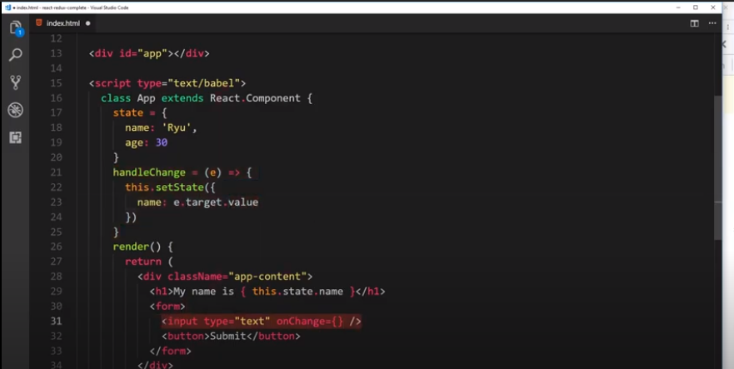

Slide 6
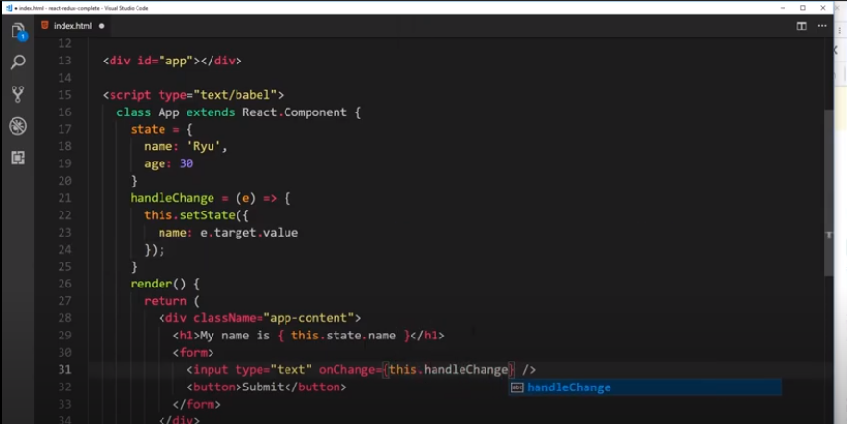

Slide 7
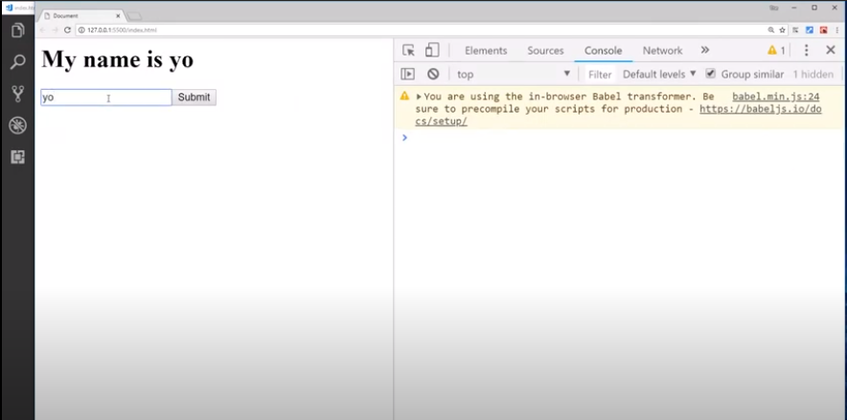

Slide 8
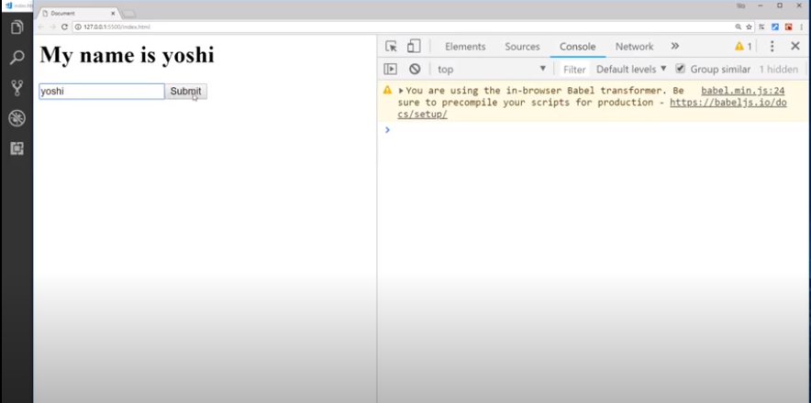
When click on submit page will be refresh default event of form submit

Slide 9
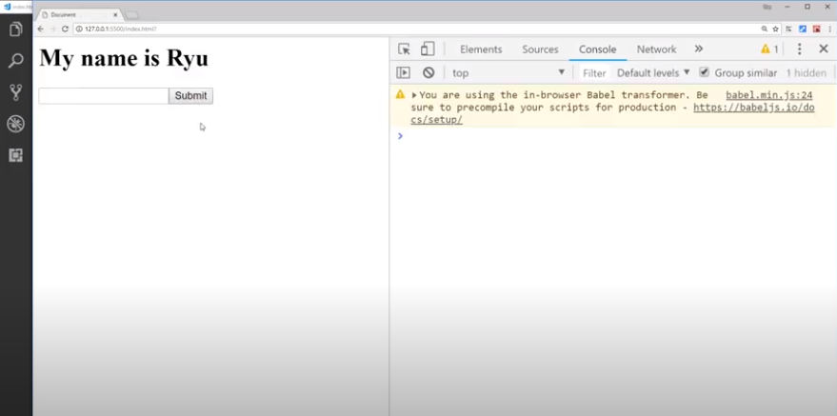

Slide 10
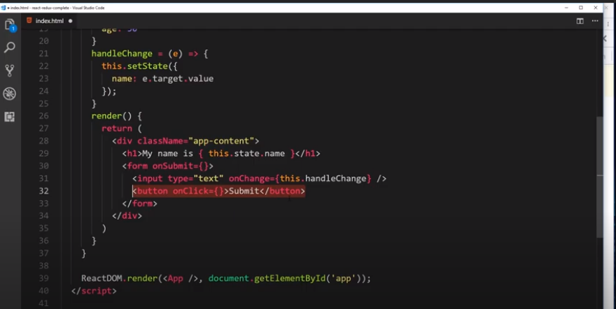
Only trigger when button will be clicked not on Enter pressed

Slide 11
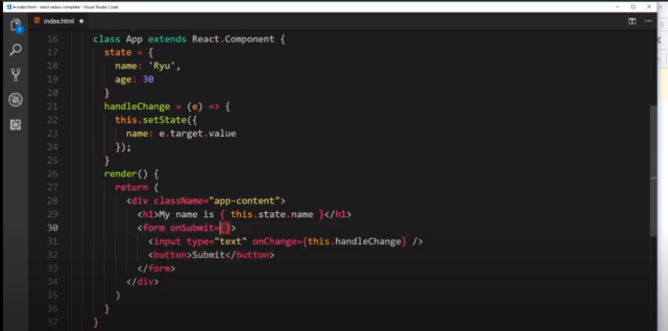

Slide 12
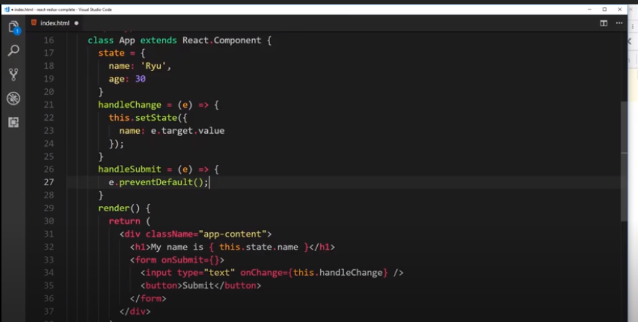
Now page will not be refreshed

Slide 13
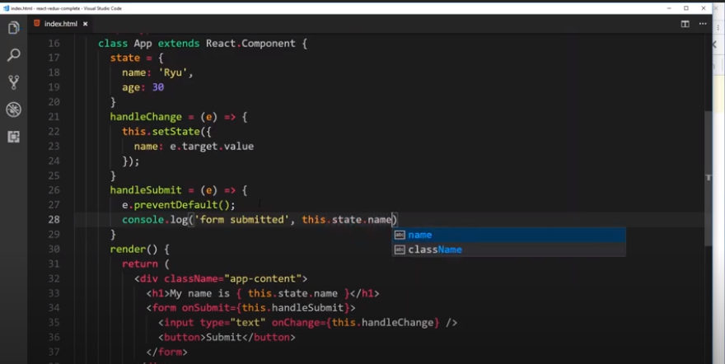

Slide 14
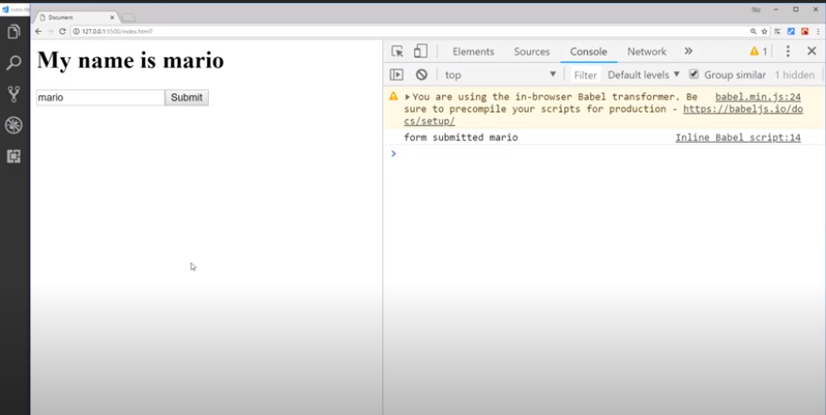

Slide 15
Create React App

Slide 16
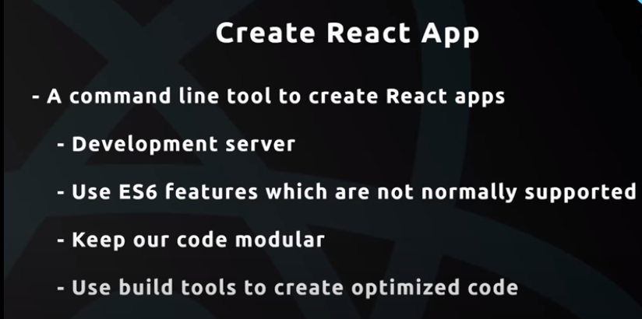

Slide 17
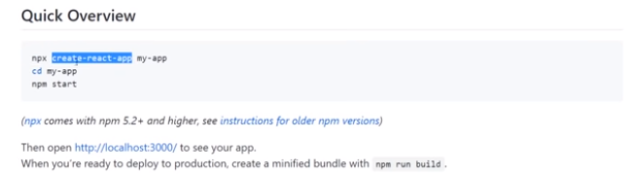

Slide 18
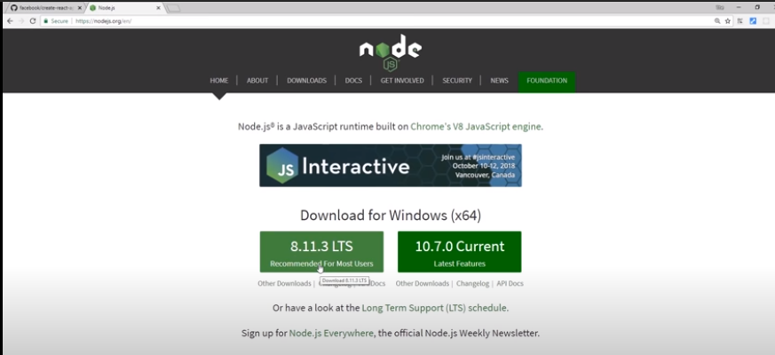

Slide 19
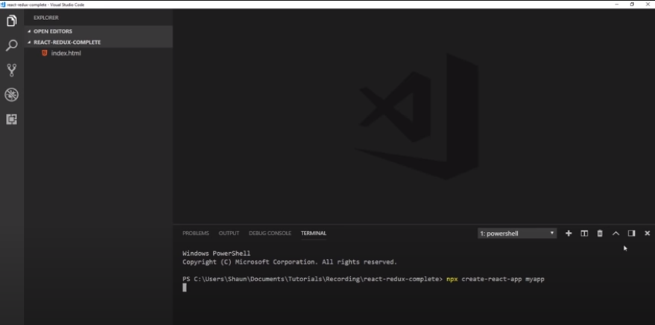
Creating app with command

Slide 20
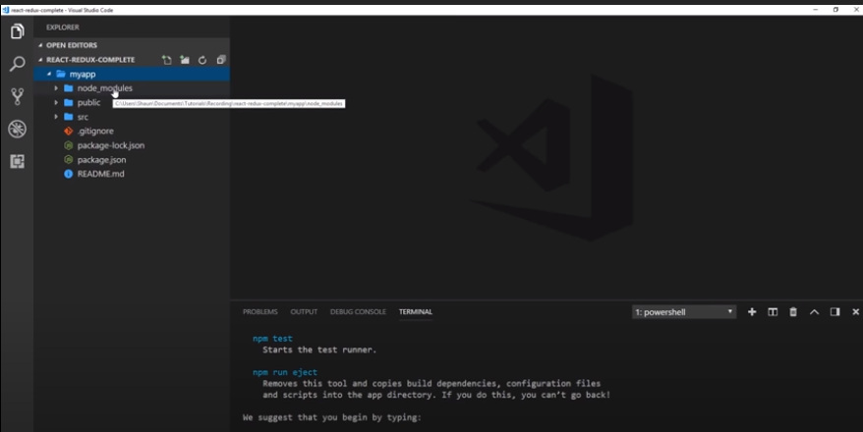

Slide 21
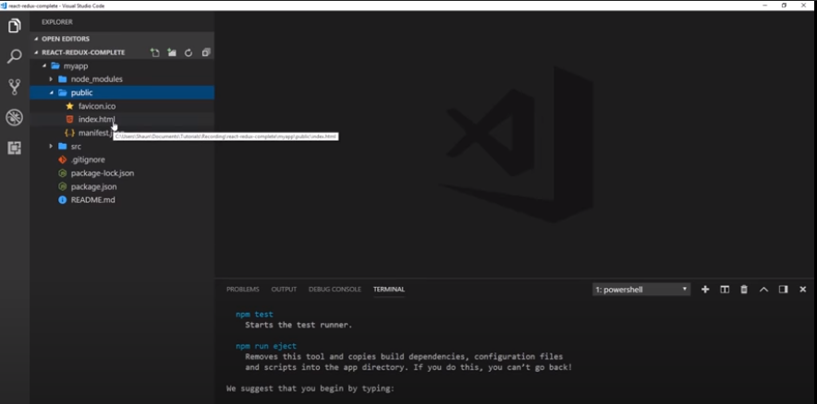

Slide 22
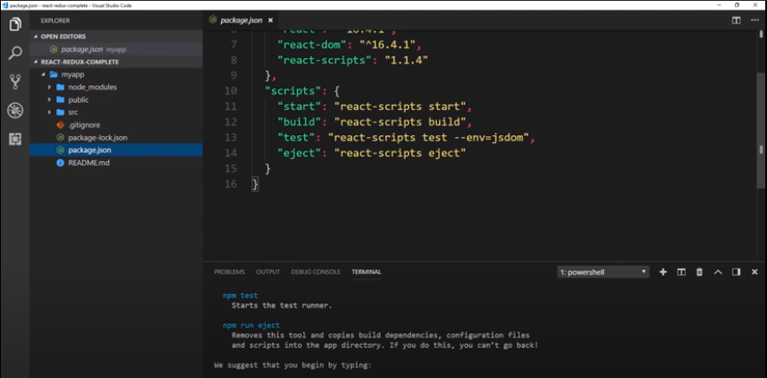

Slide 23
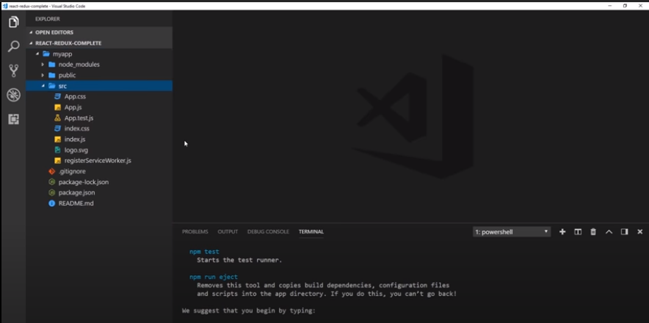

Slide 24
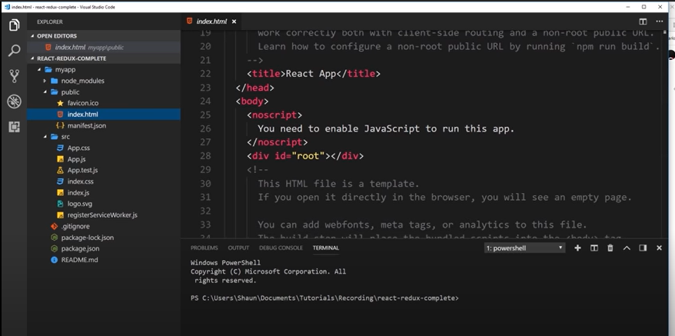
Basically this index.html is our one page app. All the components will be injected dynamically in this root div

Slide 25
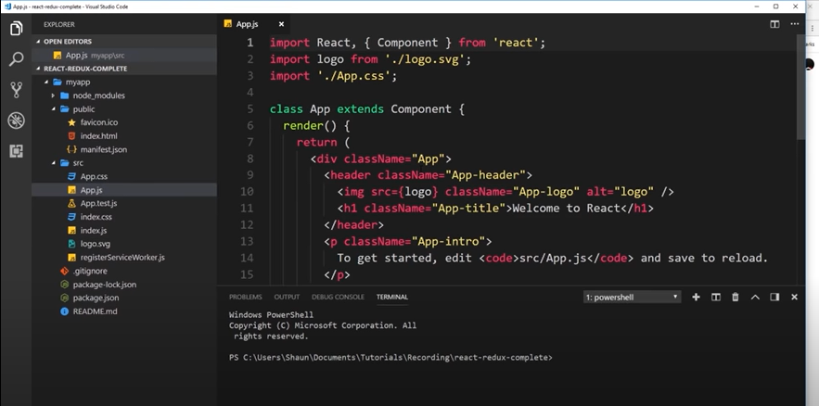
First component React created for us with name App.
Its same which we saw earlier like a class based component with render method having a jsx template code, returning a div.

Slide 26
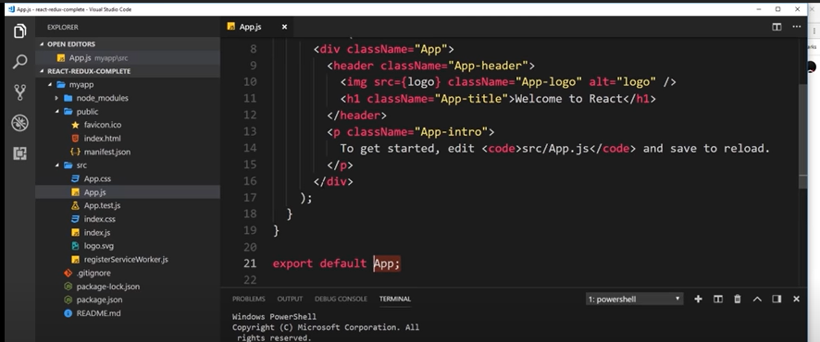
At the end we are exporting that component so that we can render it to the DOM.

Slide 27
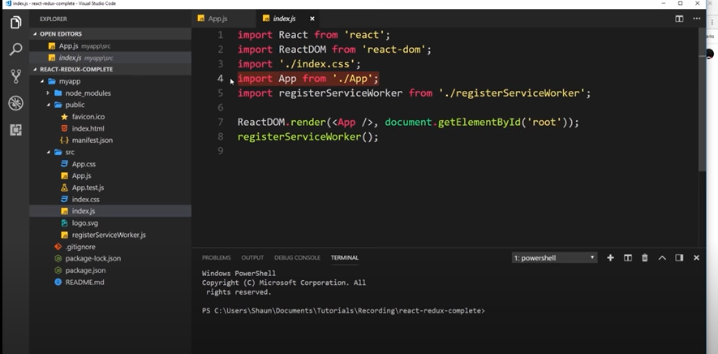
Importing that component in index.js and rendering it to the root element of index.html
So basically here we are inject our component with ReactDOM.render method

Slide 28
How to run this app

Slide 29
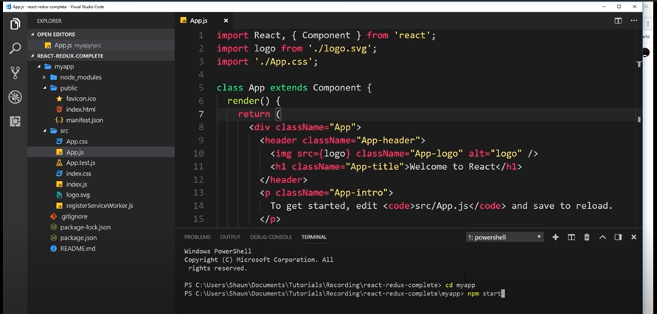
Firstly with cd command will go into the directory
Then will start a local server

Slide 30
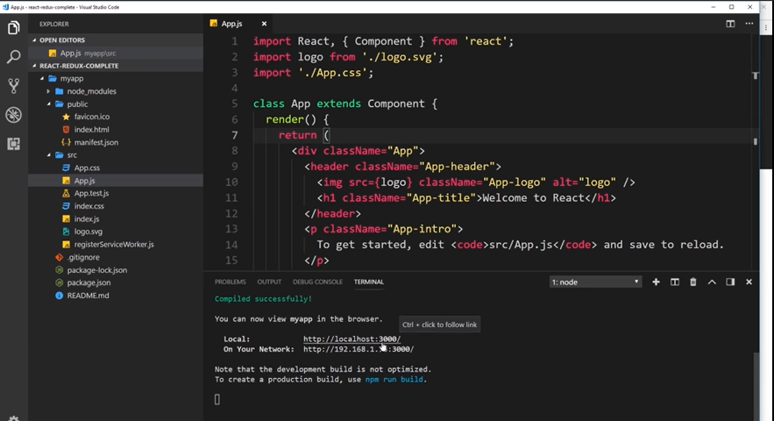
It will shows the ip address where that app is running

Slide 31
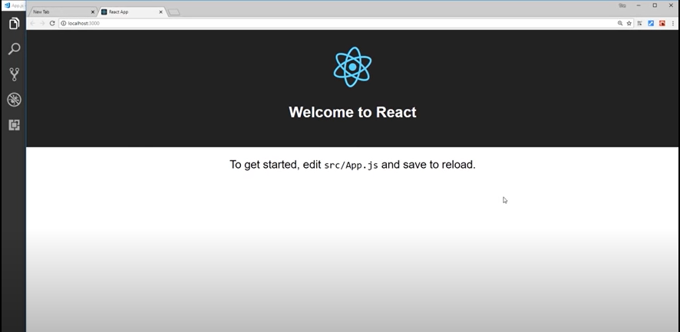
It will also be opened in browser automatically

Slide 32
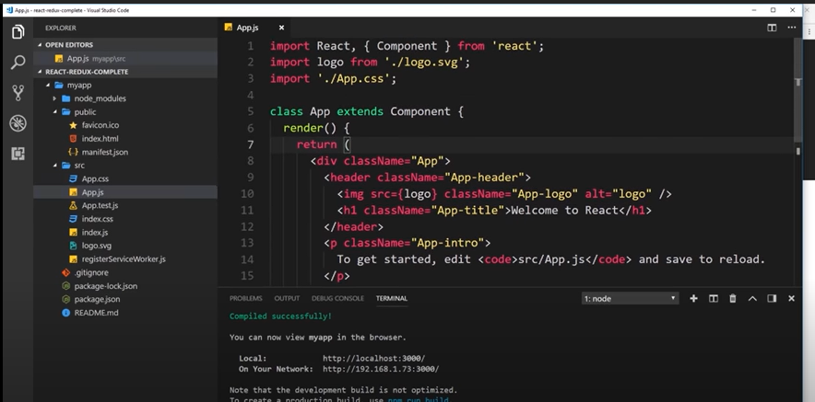
All the text on the browser is coming from here: App component

Slide 33
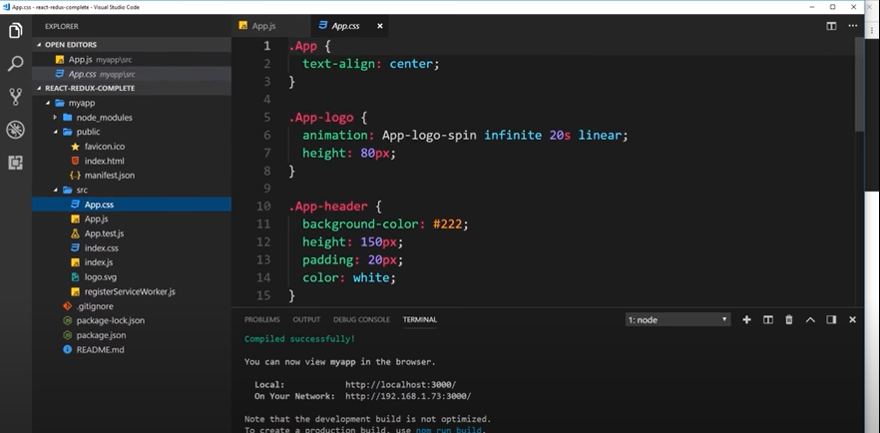
Lets delete the css file. We do not going to show that default text on browser like its logo

Slide 34
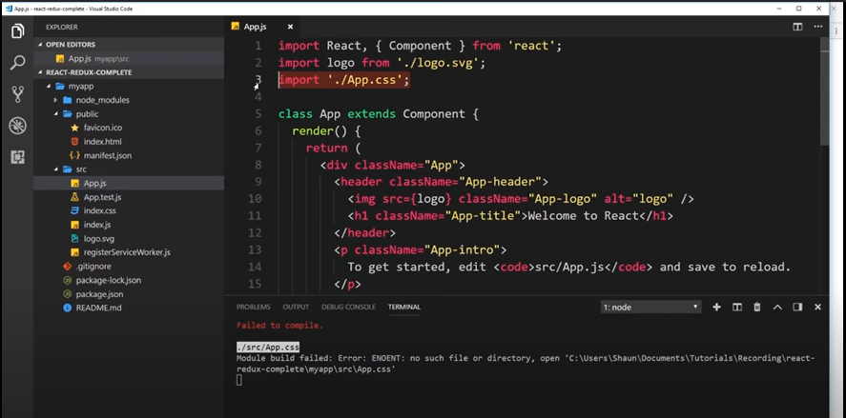
Also delete the reference of the previous css file

Slide 35
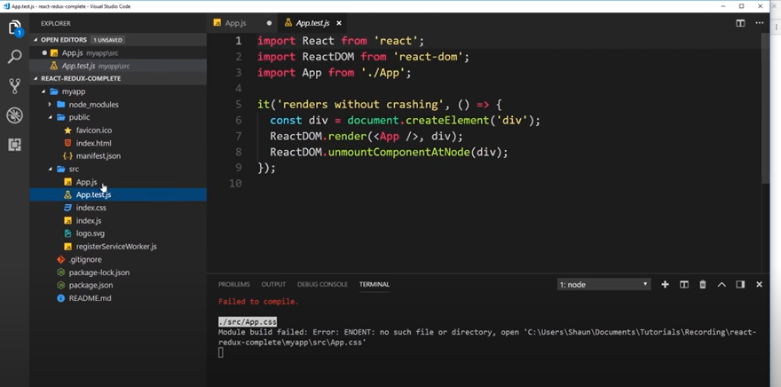
Also delete the test file. No need at this time

Slide 36
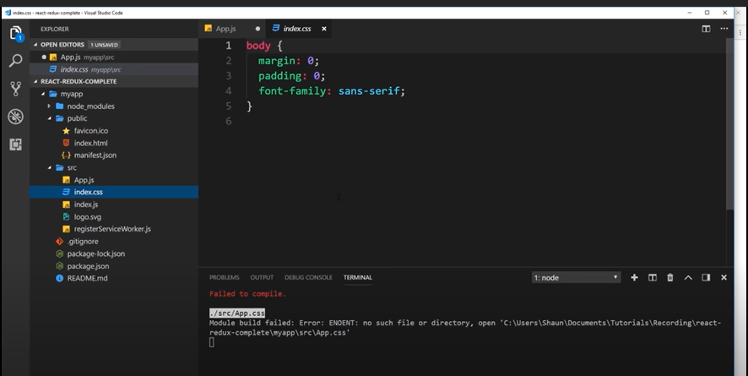
So now basically we have
App.js file which is our component.
Index.css which is a global css file of our project we can also add more css in this file.
Index.js file where we render the component to the DOM.
Logo.svg delete this logo too we have no further need.
registerServiceWorker.js file which manage cache for best user experience leave it…

Slide 37
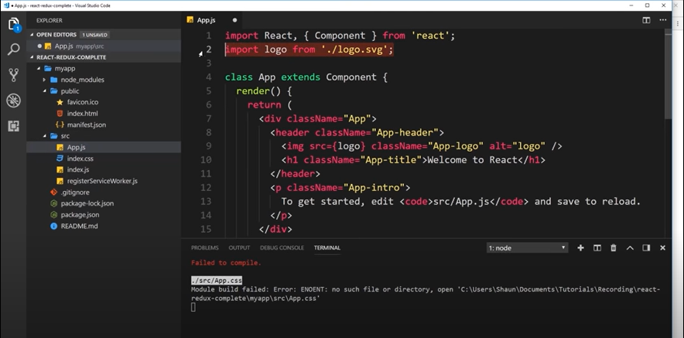
Delete the import logo line we have no more this logo and also delete the image tag where we are putting logo.

Slide 38
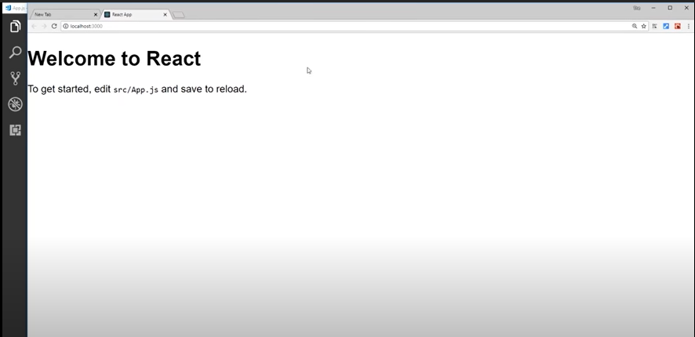
Now in the browser we will have:
Simple Right?

Slide 39
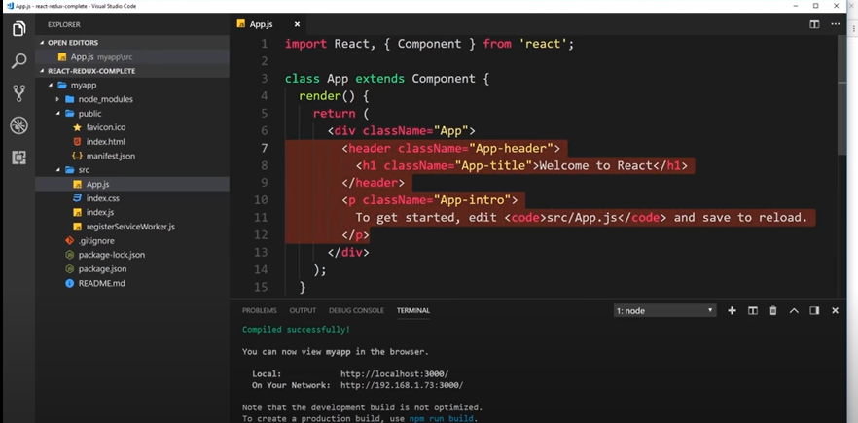
Delete the rest too

Slide 40
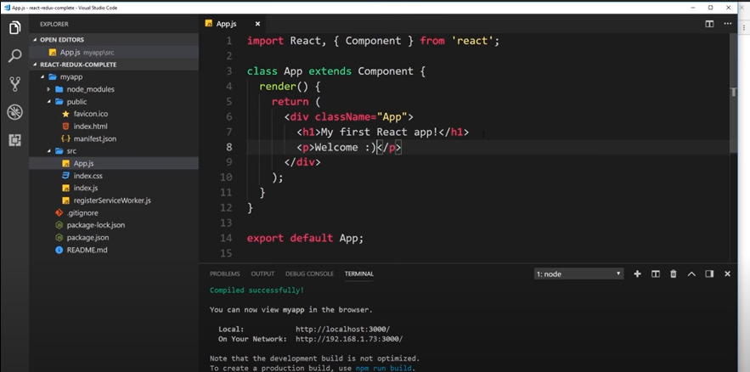
Add simple template

Slide 41
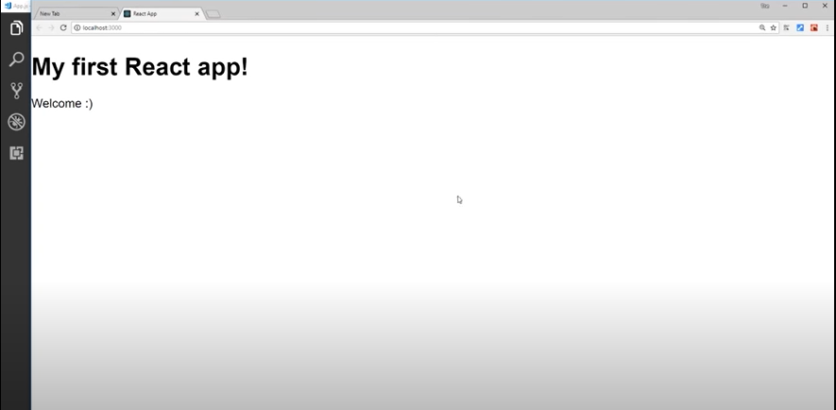
When you hit Ctrl +S key it will automatically updated on the browser

Slide 42
Single Page Apps

Slide 43
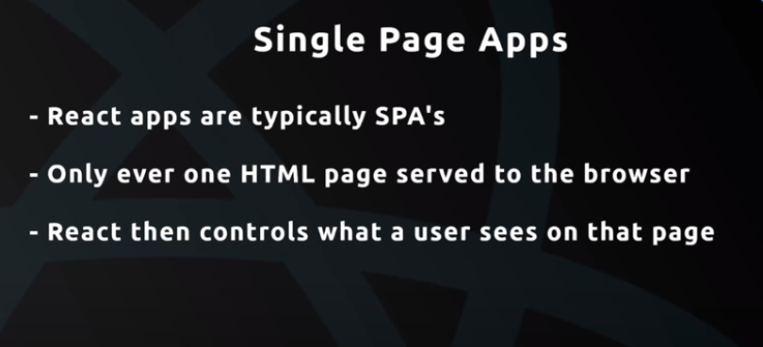

Slide 44
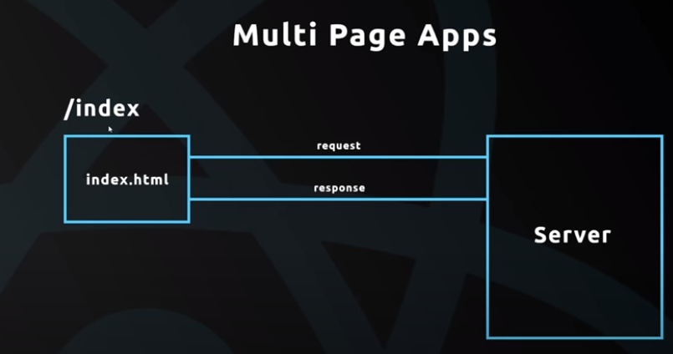

Slide 45
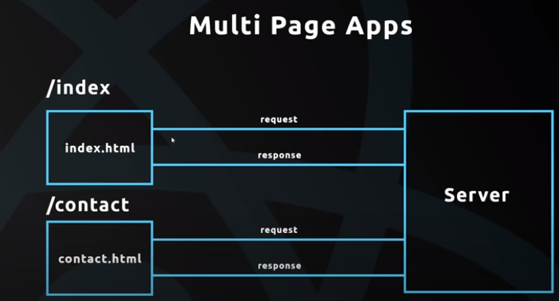

Slide 46
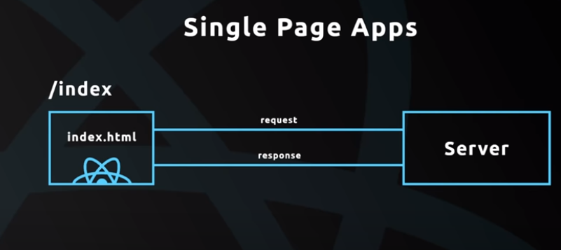

Slide 47
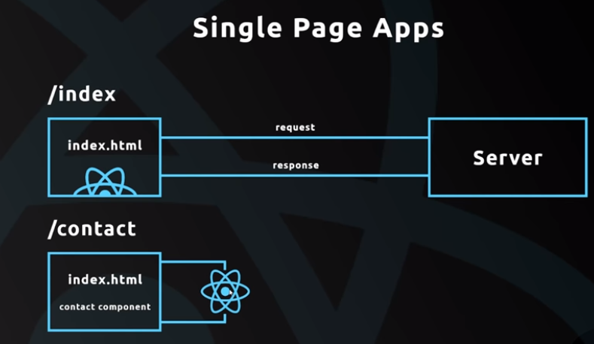

Slide 48
Nesting Components

Slide 49
In React root component is App.js we can nesting more components in it

Slide 50
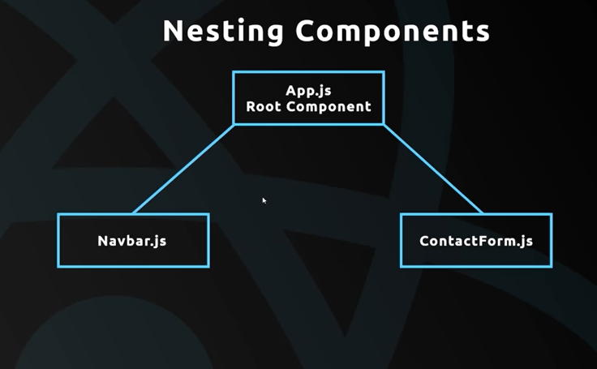

Slide 51
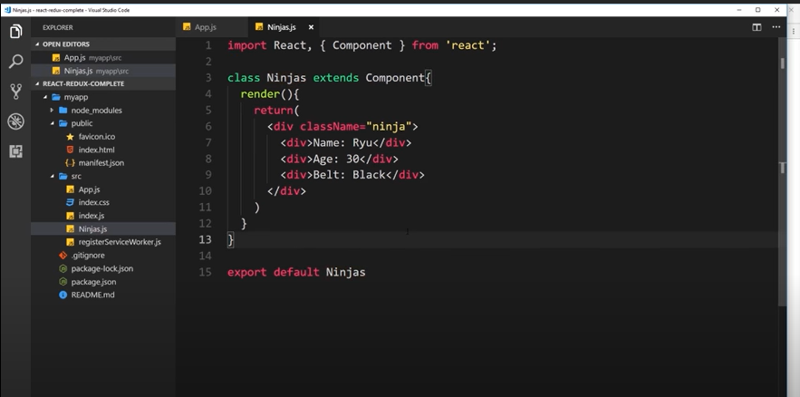
Creating another component with name Ninjas in src directory

Slide 52
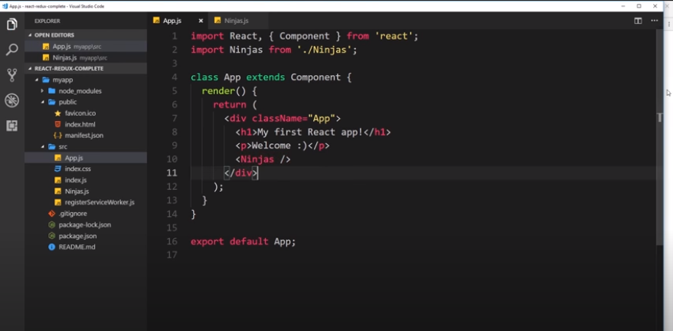
Injecting component

Slide 53
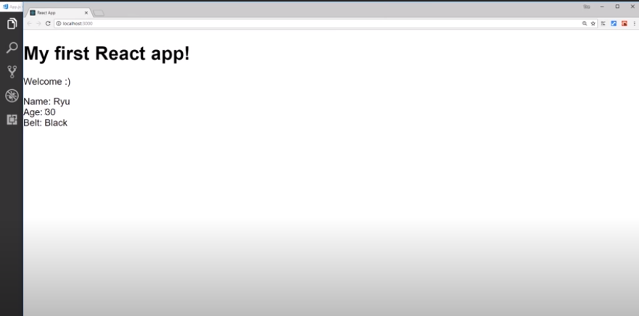

Slide 54
Props

Slide 55
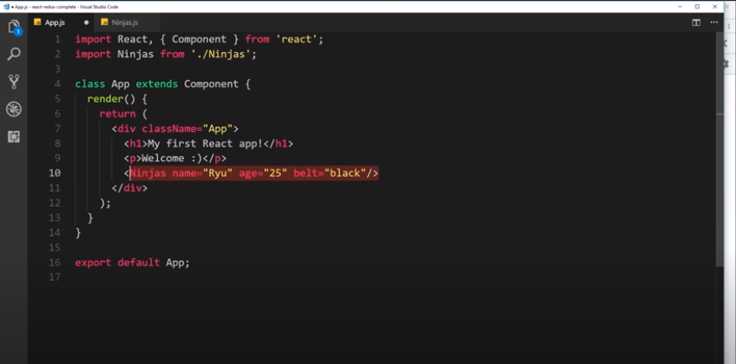
Passing data to component (Parent to child)

Slide 56
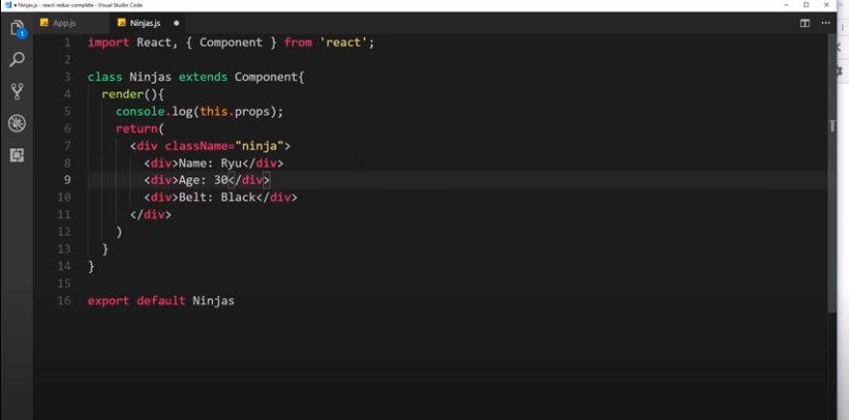

Slide 57
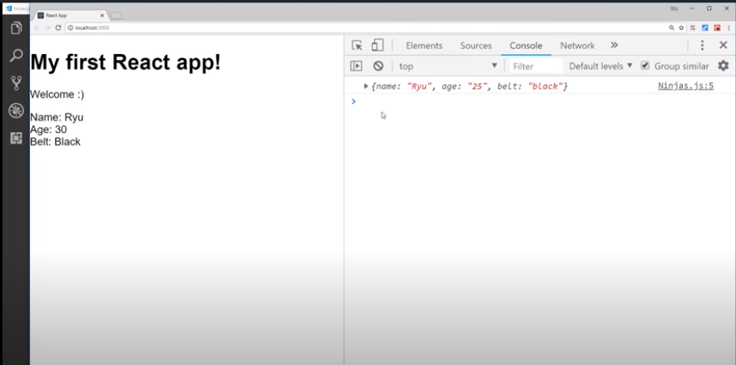

Slide 58
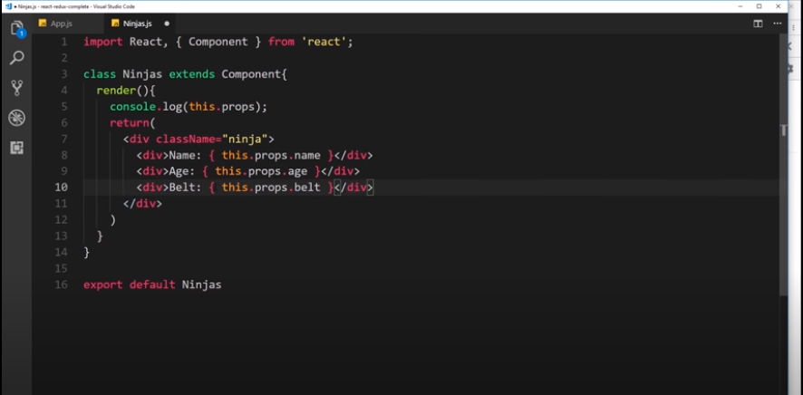

Slide 59
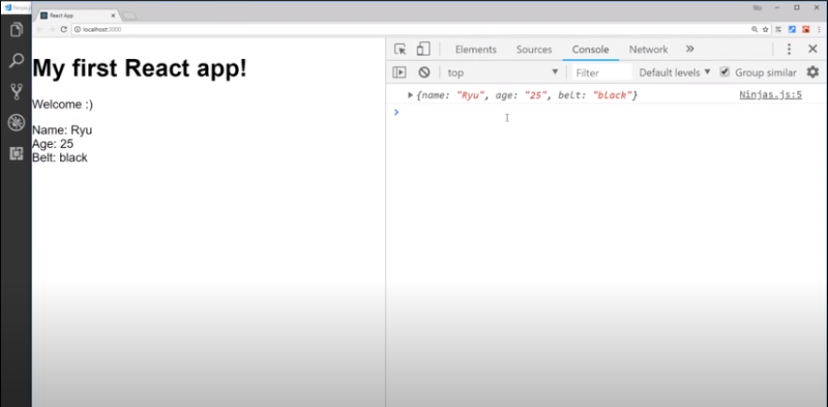

Slide 60


Slide 61

Still same output

Slide 62

Use same component with diff values: dynamic behavior

Slide 63

What it looks on browser

Slide 64
Outputting Lists

Slide 65


Slide 66


Slide 67


Slide 68


Slide 69


Slide 70


Slide 71


Slide 72


Slide 73


Slide 74


Slide 75
Stateless Components

Slide 76

Container components are not concerned with UI or look of app
Container Comp.=Statefull Comp.=Class based Comp.
UI Comp.=Stateless Comp.=Functional Comp.

Slide 77


Slide 78


Slide 79


Slide 80


Slide 81


Slide 82


Slide 83

Final One

Slide 84


Slide 85


Slide 86

If have many

Slide 87

Also write this

